Slide 1
W10 - Survey
20221108 Meeting

Slide 2
Content
分散風險的儲存架構
羅寶瑩
王靖婷
秦宗佑
廖苡辰
區塊鍊 + 零知識驗證
蔡佳誠
霍芷媛
張麒仙

Slide 3
參考內容
1. 近期有人在做相關研究嗎, 他們簡潔來說是如何做
2. 如何實作(包含產生實驗資料)
3. 如何評斷performance
4. 有進步空間嗎(他們沒有做好或其他待改善的部分)
5.其他皆可

Slide 4
分散風險的儲存架構
羅寶瑩

Slide 5
Cryptographic splitting

Slide 6
Cryptographic splitting
a technique for securing data over a computer network
Steps
encrypting data
splitting the encrypted data into smaller data units
distributing those smaller units to different storage locations
and then further encrypting the data at its new location.
With this process, the data is protected from security breaches, because even if an intruder is able to retrieve and decrypt one data unit, the information would be useless unless it can be combined with decrypted data units from the other locations.

Slide 7
Application
Security for cloud computing
The encrypted data subsets can be stored on different clouds
Company using this technology
Security vendor Security First Corp uses this technology for its Secure Parser Extended (SPx) product line
Computer giant IBM has written about using the technology as part of its Cloud Data Encryption Services (ICDES)

Slide 8
How?
AES-256
A block of data is first encrypted
Cryptographic Splitting
The encrypted bits are then split into N shares
SHA-256
Each individual share is hashed

Slide 9
How?
Workgroup Key
External
Symmetric, 256 bits
Session Key
Internal
Contains encryption, splitting, and hash keys
Encrypted with the Workgroup key
Used on no more than 64GB of data

Slide 10
How?
Data is encrypted and split into N shares
Each share is saved on a separate disk
The loss of any one disk cannot compromise the data
A storage appliance in the SAN performs the encryption
The appliance has a hardware assist to improve performance

Slide 11
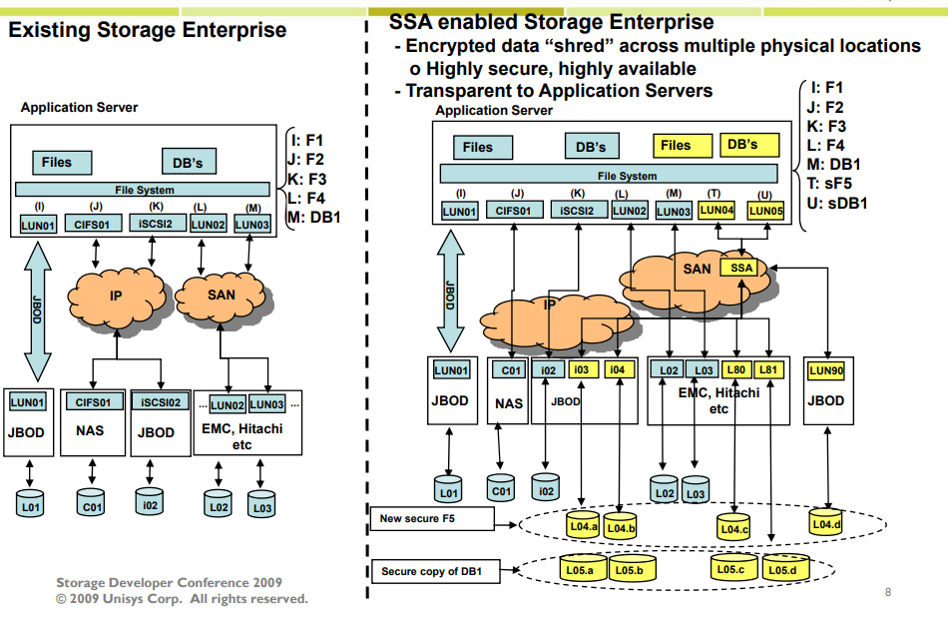
SAN
Configuration

Slide 12
Redundancy
The splitting algorithm provides redundancy
Specified as “M of N” where N is the number of shares and M is the minimum number required
For example, “2 of 4” means that data is written to 4 shares, but only 2 reads are required to reconstitute the data

Slide 13
Caching
Front-end
Recently accessed data can be saved on the appliance
Data doesn’t have to be decrypted
Primarily improves read performance
Back-end
Data for remote shares can be saved locally
Saved in encrypted format
Primarily improves write performance

Slide 14
Key Splitting

Slide 15
Key Splitting
A process by which a cryptographic key is split into multiple key components
individually sharing no knowledge of the original key
which can be subsequently input into, or output from, a cryptographic module by separate entities
and combined to recreate the original cryptographic key.

Slide 16
Splitting Example
Start with the Key1 (using the ANSI standard key for this example):
0123456789ABCDEFFEDCBA9876543210
create a random number of the same length (16 bytes in this example):
0452DDB661F7DCDC1046C2F044CAAAD5 (this will become key Component1)
XOR the 2 numbers (Component1 and Key1):
0452DDB661F7DCDC1046C2F044CAAAD5 XOR 0123456789ABCDEFFEDCBA9876543210 =
057198D1E85C1133EE9A7868329E98C5 (the result will be key component 2)
Key: 0123456789ABCDEFFEDCBA9876543210 KCV:08D7B4
Component1: 0452DDB661F7DCDC1046C2F044CAAAD5
Component2: 057198D1E85C1133EE9A7868329E98C5
The KCV is the "Key Check Value" for the key, calculated by assuming the key/components are 3DES keys, and encrypting a string of binary zeroes. The KCV is the first six hex digits of the resulting ciphertext.
https://www.emvlab.org/keyshares/

Slide 17
Papers

Slide 18
Symmetric Encryption on the Base of Splitting Method
a method of secured transmitting of information by using splitting encryption algorithm which replaces each character in plaintext by k-integer in ciphertext
shows how to use a set of cryptographic keys which are generated using genetic algorithm and pseudorandom number generators, to solve some of serious problems in the modern cryptography

Slide 19
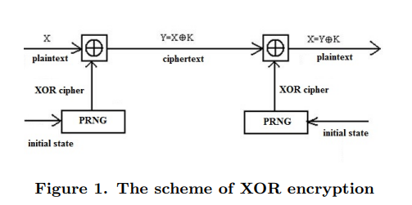
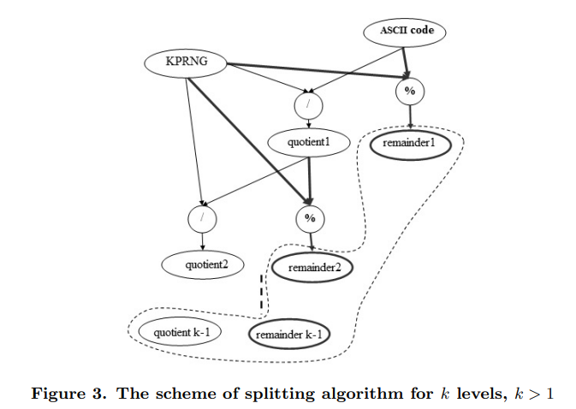
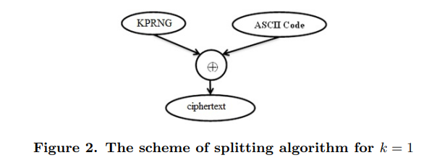

Slide 20
Insider Threats and Cryptographic Techniques in Secure Information Management
presents some techniques for insider threats and cryptographic protocols in secure processes
propose a new protocol that allows to protect data in different management structures
The presented data splitting techniques will concern cryptographic information splitting algorithms, as well as data sharing algorithms making use of cognitive data analysis techniques.
concern data reconstruction methods and cognitive data analysis techniques

Slide 21
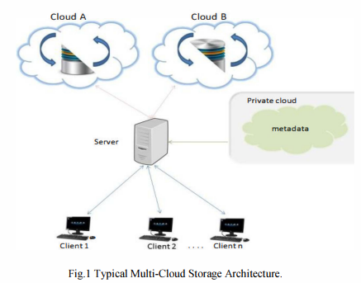
Enhanced Security for Multi-Cloud Storage using Cryptographic Data Splitting with Dynamic Approach
multi cloud model which is based on partitioning of application system into distinct clouds instead of using single cloud service such as in Amazon cloud service .
It will discuss and present the cryptographic data splitting with dynamic approach for securing information. The metadata information is stored in private cloud.
This approach prevents the unauthorized data retrieval by hackers and intruders. The results and implementation for the new proposed model is analyzed, in relation to addressing the security factors in cloud computing.

Slide 22
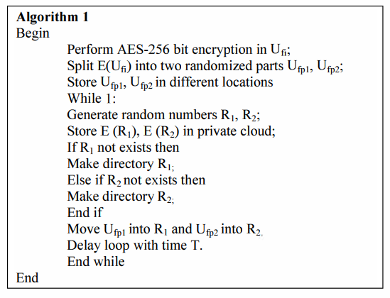

Slide 23
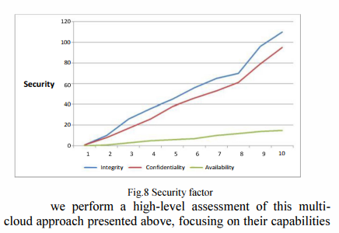
Performance analysis
using only the transfer rate and transfer size
e. The delay is due to transfer factor of multi-cloud approach because each file slices are stored in distinct cloud storages
the encryption and decryption process is computationally fast since the symmetric encryption algorithm (AES) is used

Slide 24
Reference
Cryptographic splitting
https://en.wikipedia.org/wiki/Cryptographic_splitting
Dodgson, David. "Storage Security Using Cryptographic Splitting" (PDF). snia.org. Retrieved 2016-09-23. - https://www.snia.org/sites/default/orig/sdc_archives/2009_presentations/wednesday/DavidDodgson_StorageSecurityUsingCryptographicSplitting-BU.pdf
Key Splitting
How does one split / combine cryptographic keys? - https://atlassian.idtechproducts.com/confluence/pages/viewpage.action?pageId=40633270
Keyshare Generator - https://www.emvlab.org/keyshares/

Slide 25
Reference
Insider Threats and Cryptographic Techniques in Secure Information Management - https://ieeexplore.ieee.org/abstract/document/7067420
Enhanced security for multi-cloud storage using cryptographic data splitting with dynamic approach - https://ieeexplore.ieee.org/document/7019286
Symmetric Encryption on the Base of Splitting Method - https://journals.rudn.ru/miph/article/view/13401/0

Slide 26
分散風險的儲存架構
王靖婷

Slide 27
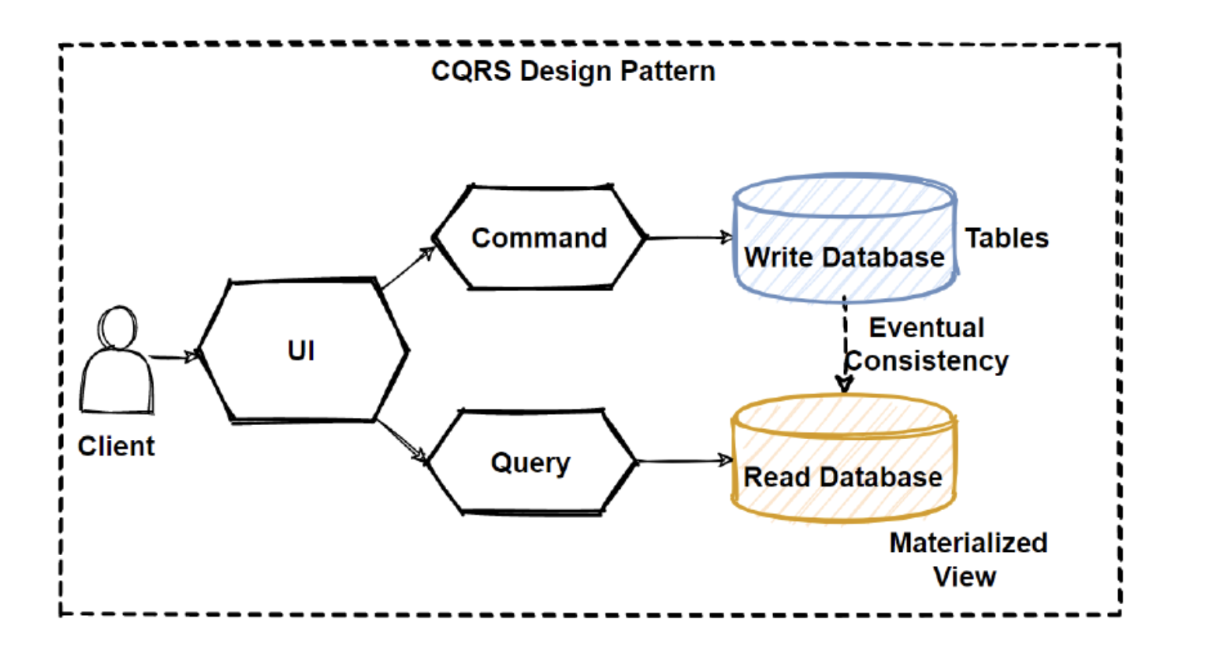
CQRS
https://medium.com/design-microservices-architecture-with-patterns/cqrs-design-pattern-in-microservices-architectures-5d41e359768c

Slide 28
https://medium.brobridge.com/%E6%B7%BA%E8%AB%87-cqrs-%E5%AF%A6%E7%8F%BE%E6%96%B9%E6%B3%95-3b4fcb8d5c86
https://learn.microsoft.com/zh-tw/dotnet/architecture/microservices/architect-microservice-container-applications/distributed-data-management

Slide 29
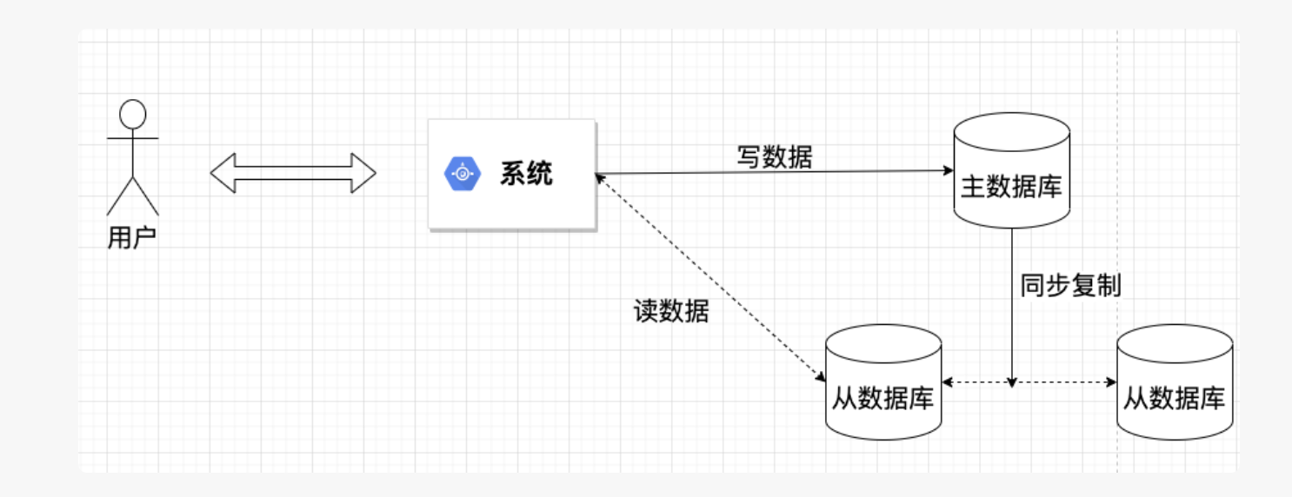
Reference
xxx.com
xxxxxx
xxxxx

Slide 30
分散風險的儲存架構
秦宗佑

Slide 31
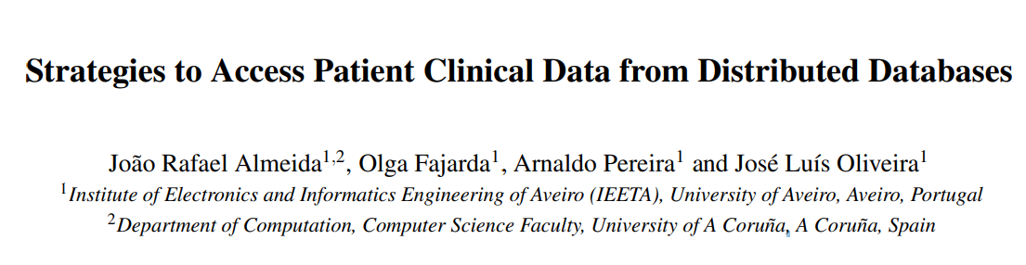
Brief intro
Nowadays, due to the worldwide generalisation of electronic health record (EHR) systems and the digitisation of health-related information, a vast number of electronic health databases, containing diversified clinical digital data, exists

Slide 32
Brief intro
Nowadays, due to the worldwide generalisation of electronic health record (EHR) systems and the digitisation of health-related information, a vast number of electronic health databases, containing diversified clinical digital data, exists.

Slide 33
Brief intro
The reluctance of the health database owners to share their data is due to several reasons.
The main reasons concerns:
data ownership
intellectual property rights
the lack of a common strategy for data sharing.

Slide 34
Brief intro
In order to support such studies, while ensuring data privacy and security, a strategy for querying different databases in a mediated way is needed.
Analyzing 2 different strategies to perform distributed queries in health databases.
Both approaches use open-source solutions and can offer alternative pipelines to help researchers answer their questions without the need for direct access to data.
The 1st approach is based on the use of a common data model
The 2nd on the application of Semantic Web(SW) principles

Slide 35
Brief intro
Several solutions have been developed for the secure sharing of patient clinical data from distributed databases.
CALIBER
PopMedNet
OHDSI
EMIF

Slide 36
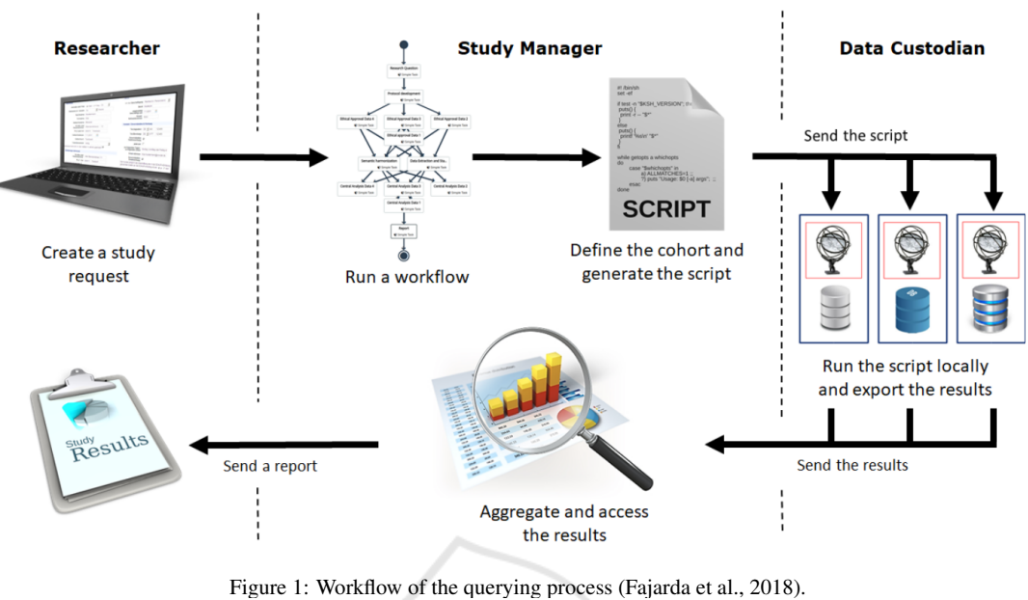
Notes:
The approaches were evaluated based on a set of selection criteria created from the authors’ experience in the application of each of the approaches.
Both approaches are similar when we consider the data quality criteria.
The Common Data Model solution is more performant for the cost, consistency, and efficiency.
When considering interoperability and extendibility, the Semantic Web approach is more favourable.

Slide 37
Common Data Model Approach
Requiring that Data Custodians’ databases use a shared schema to all. Therefore, a model must be delineated, which is currently not a problem, since there are already some common data models defined for observational studies, e.g. the OMOP CDM. This common data model is, already used in several countries (Hripcsak et al., 2015)
OHDSI created several tools to guide the different specialised entities involved. These specialised entities are:
Local data experts and CDM experts, which together design the ETL transformation, without creating the migration script
People with medical knowledge, which define the code mappings
A technical person, which creates and implements the ETL scripts following the specifications
However, despite all of these tools and protocols design to help these entities, it is still impossible to fully automate this process.

Slide 38
Common Data Model Approach
The Study Manager and the Data Custodians can use some tools to extract and analyse the data, e.g. ATLAS.
The Study Manager can define a cohort and send the resulting extraction script to all the Data Custodians.
The Data Custodians can, then, execute the script received, in their local ATLAS installation, which provides a result, that can be analysed and filtered, before being sent to the Study Manager.
This procedure ensures that Data Custodians have full control over their data and keeps nonauthorised users away from patients data, preserving data privacy.

Slide 39
Semantic Web Approach
Nowadays, semantic technologies are at the core of many systems that support data-intensive research areas, as is the case with system biology, integrative neuroscience, bio-pharmaceutics and translational medicine, just to mention a few cases (Chen et al., 2013).
In addition, numerous repositories are using the SW data model that can be accessed over the Internet (Zaveri and Ertaylan, 2017), due to the existence of stable standards and best practice guidelines.

Slide 40
Semantic Web Approach
The Semantic Web approach relies on the conversion of the original data into RDF format. This conversion must be performed for each distributed database by using a convenient solution, such as the SCALEUS tool.
After the creation of the semantic model for the domain of interest and the data conversion into RDF, the SPARQL query language is the convenient tool for extracting knowledge from the created semantic database.

Slide 41
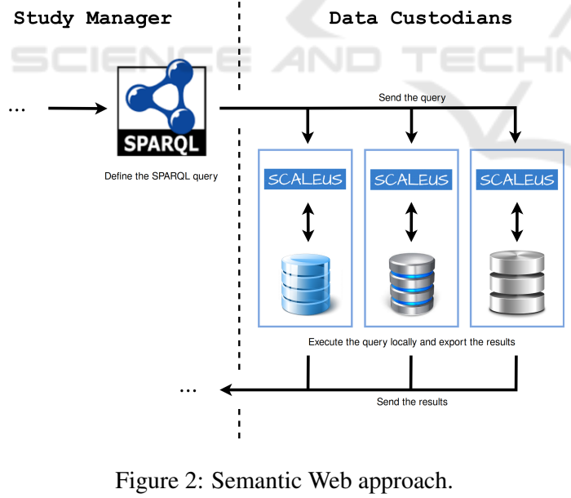
Semantic Web Approach
Figure 2 presents a snippet of the query pipeline. In this scenario, the Study Manager uses SPARQL to create the desired query and send it to the Data Custodians. Then, the Data Custodians sends back the patients’ data to the Study Manager, for interpretation and compilation of results.

Slide 42
Semantic Web Approach
The Semantic Web approach relies on the conversion of the original data into RDF format. This conversion must be performed for each distributed database by using a convenient solution, such as the SCALEUS tool.
After the creation of the semantic model for the domain of interest and the data conversion into RDF, the SPARQL query language is the convenient tool for extracting knowledge from the created semantic database.
—
The SCALEUS solution provides a set of data connectors and interfaces that help in the translation process to a user pre-defined model (ontology) to be negotiated between the Data Custodians. Although migration tasks are simplified, the need for consensus among Data Custodians may make it difficult to use this option.

Slide 43
Comparison
The approaches were evaluated based on a set of selection criteria created from the authors’ experience in the application of each of the approaches.
Both approaches are similar when we consider the data quality criteria.
The Common Data Model solution is more performant for the cost, consistency, and efficiency.
When considering interoperability and extendibility, the Semantic Web approach is more favourable.

Slide 44
Reference
Strategies to Access Patient Clinical Data from Distributed Databases. January 2019. DOI:10.5220/0007576104660473. Conference: 12th International Conference on Health Informatics
https://oldmo860617.medium.com/%E5%88%9D%E6%AD%A5%E8%AA%8D%E8%AD%98%E5%88%86%E6%95%A3%E5%BC%8F%E8%B3%87%E6%96%99%E5%BA%AB%E8%88%87-nosql-cap-%E7%90%86%E8%AB%96-a02d377938d1

Slide 45
分散風險的儲存架構
廖苡辰

Slide 46
資料庫系統的分類
集中式資料庫系統（Centralized Database, CDB）
分散式資料庫系統（Distributed Database, DDB）

Slide 47
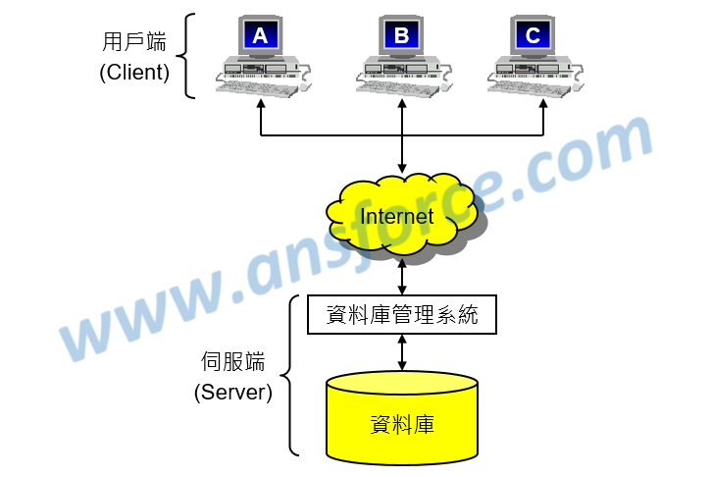
集中式資料庫系統（Centralized Database, CDB):
所有資料都集中給一台伺服器處理
優
容易管理資料
缺
風險較高
資料傳輸率容易受網路流量影響
伺服器的負擔很重

Slide 48
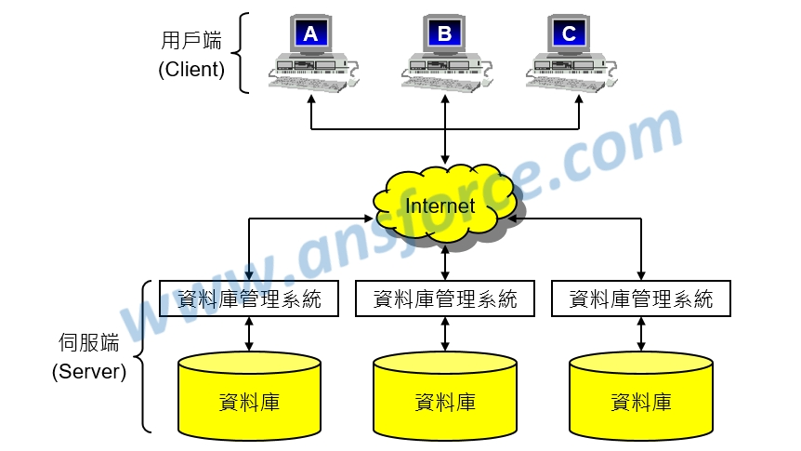
分散式資料庫系統（Distributed Database, DDB）
將資料依照特性分散儲存在不同的資料庫伺服器，再以網路將這些伺服器連接起來

Slide 49
分散式資料庫系統的軟體架構
分散式資料庫（Distributed Database, DDB）
資料是分散儲存在以網路連接的不同資料庫伺服器上。
分散風險
資料傳輸率不易受網路流量影響
分散式資料庫管理系統（Distributed Database Management System, DDBMS）
管理分散式資料庫的軟體。
具有「通透性（Transparent）」：
使用者並不會認為他是在存取分散儲存的資料，感覺仍然是一個完整的資料庫。

Slide 50
分散式資料庫系統的資料處理
資料分割（Data fragmentation）
先將資料分割成較小的單位稱為「片斷（Fragment）」，然後再以片斷為單位分散儲存在不同的資料庫伺服器
通常由是在用戶端的應用程式進行
資料複製（Data replication）
資料複製建立備份
其中原始資料庫稱為「主資料庫（Master database）」，複製的資料庫稱為「複製資料庫（Replica）」，在主資料庫和複製資料庫之間需要定時進行同步更新才能確保資料安全。

Slide 51
分散式資料庫系統（Distributed Database, DDB）
優：
增加效能：在最近的地方就可以取得所需要的資料。
提高可靠性和可用性：就算有些伺服器當機或網路斷線，分散式資料庫系統仍然擁有足夠的妥善率，不會影響整個資料庫系統的運作。
更多的彈性和擴充性：因為資料是分散儲存在多台資料庫伺服器，要擴充只要增加伺服器同時進行設定即可，要重新配置資料庫伺服器也很容易。
可分享性：資料庫伺服器的資料可以分享，也可以只讓區域的使用者存取。
缺：
系統複雜成本高：分散式資料庫系統的複雜度相當高，相關的應用程式開發成本隨著分散程度而提高。
缺乏標準維護不易：目前並沒有分散式資料庫系統的官方標準，每家公司都使用自己的標準因此整合困難，系統維護不易，容易產生資料安全與整合問題。

Slide 52
Reference
https://www.stockfeel.com.tw/什麼是分散式資料庫？有哪些好處？/
xxxxxx
xxxxx

Slide 53
區塊鍊 + 零知識驗證
蔡佳誠

Slide 54
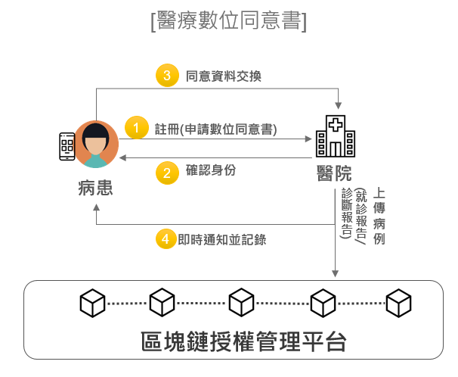
區塊鏈在醫療的相關應用
病例資料即時授權，醫療紀錄更易流通
痛點：資料在無法即時在醫院間轉移
Notes:
https://ideas-dtri.iii.org.tw/%E7%94%A2%E6%A5%AD%E5%89%B5%E6%96%B0%E6%A1%88%E4%BE%8B/block-chain-examples-in-industry/

Slide 55
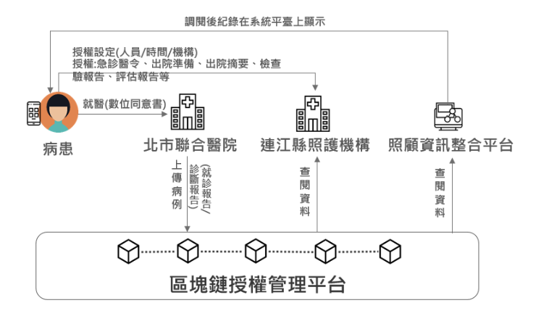
區塊鏈在醫療的相關應用
如何取用資料和分享資料
電子醫療病歷 (EMR)
個人健康紀錄 (PHR)

Slide 56
區塊鏈在醫療的相關應用
傳統電子病歷需要醫事人員卡、健保卡和機器卡等3卡的限制
執行定期離島看診服務時，透過代理授權照護資訊App，可即時調閱病患就醫資料
隨時修改或終止授權給特定醫療機構和工作人員調閱自己的醫療資料

Slide 57
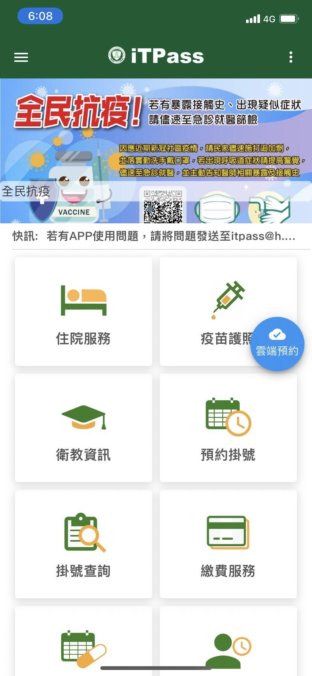
北醫 iTpass
智鏈護照
民眾可於24小時內取得完整病歷摘要、檢查影像等就醫及健檢資訊
智慧授權給其他醫院及診所醫師瀏覽，機構間轉診無須返院申請病歷
可經「智能合約」分享就醫記錄及對象

Slide 58
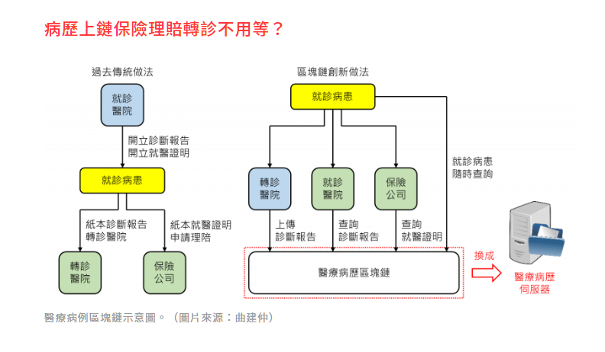
一定需要使用區塊鏈嗎
痛點：各醫院間無法互通資料
區塊鏈：慢速度、高價格、低隱私

Slide 59
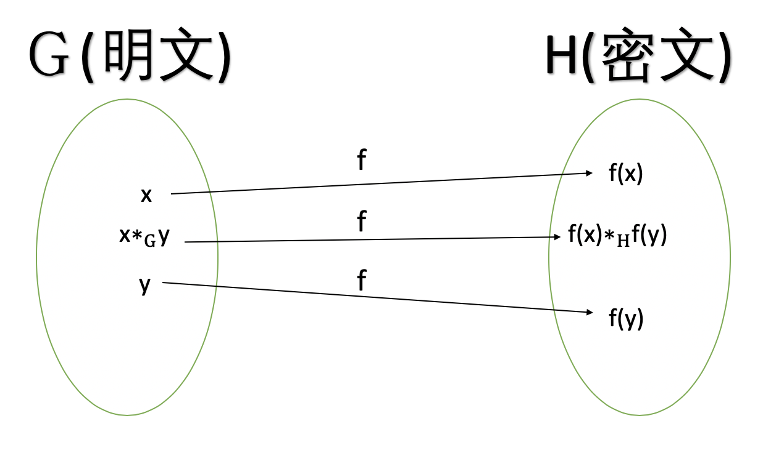
同態加密
x = 3 -> 舒張壓
y = 5 -> 收縮壓
f(x) = x + 7 -> 某些操作
f(x+y) = f(x) + f(y) = 10 + 12 = 22
Notes:
https://blog.amis.com/%E5%90%8C%E6%85%8B%E5%8A%A0%E5%AF%86-part-1-%E7%B0%A1%E4%BB%8B-c46281304fd7

Slide 60
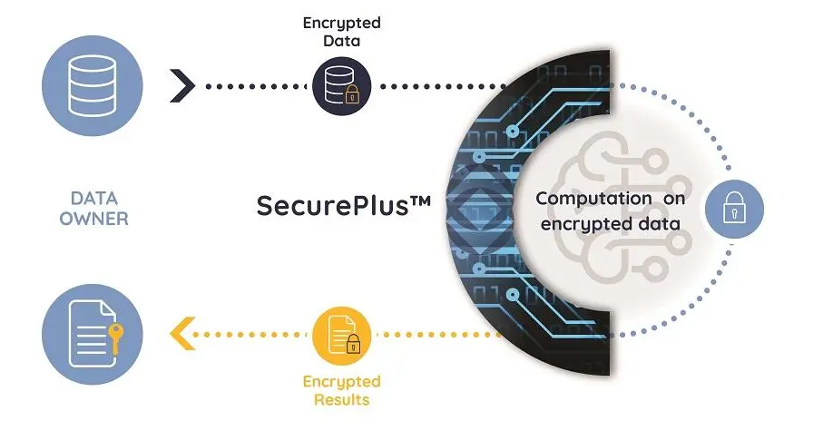
同態加密
雲端運算
機器學習

Slide 61
Reference
同態加密(Part 1 簡介)
北醫 iTpass
北醫區塊鏈應用
區塊鏈應用

Slide 62
區塊鍊 + 零知識驗證
霍芷媛

Slide 63
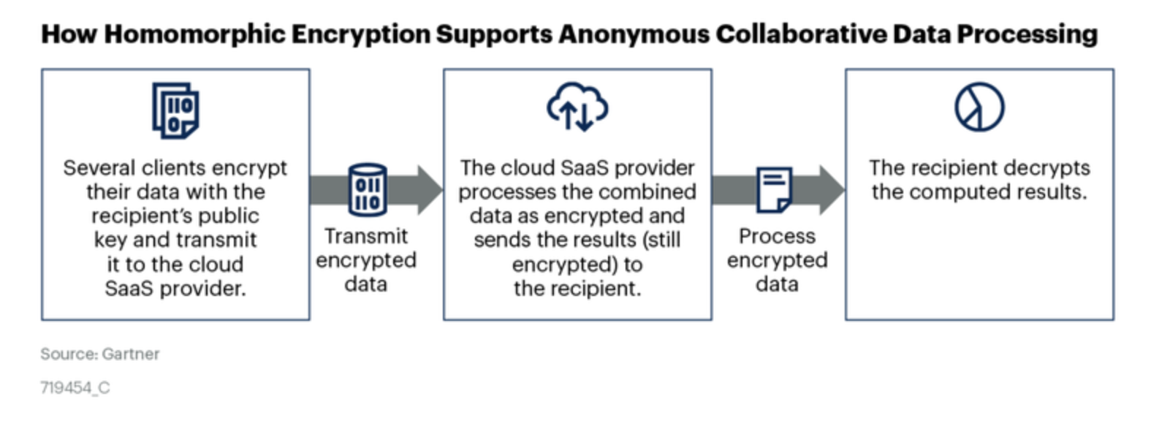
Homomorphic Encryption (HE)

Slide 64
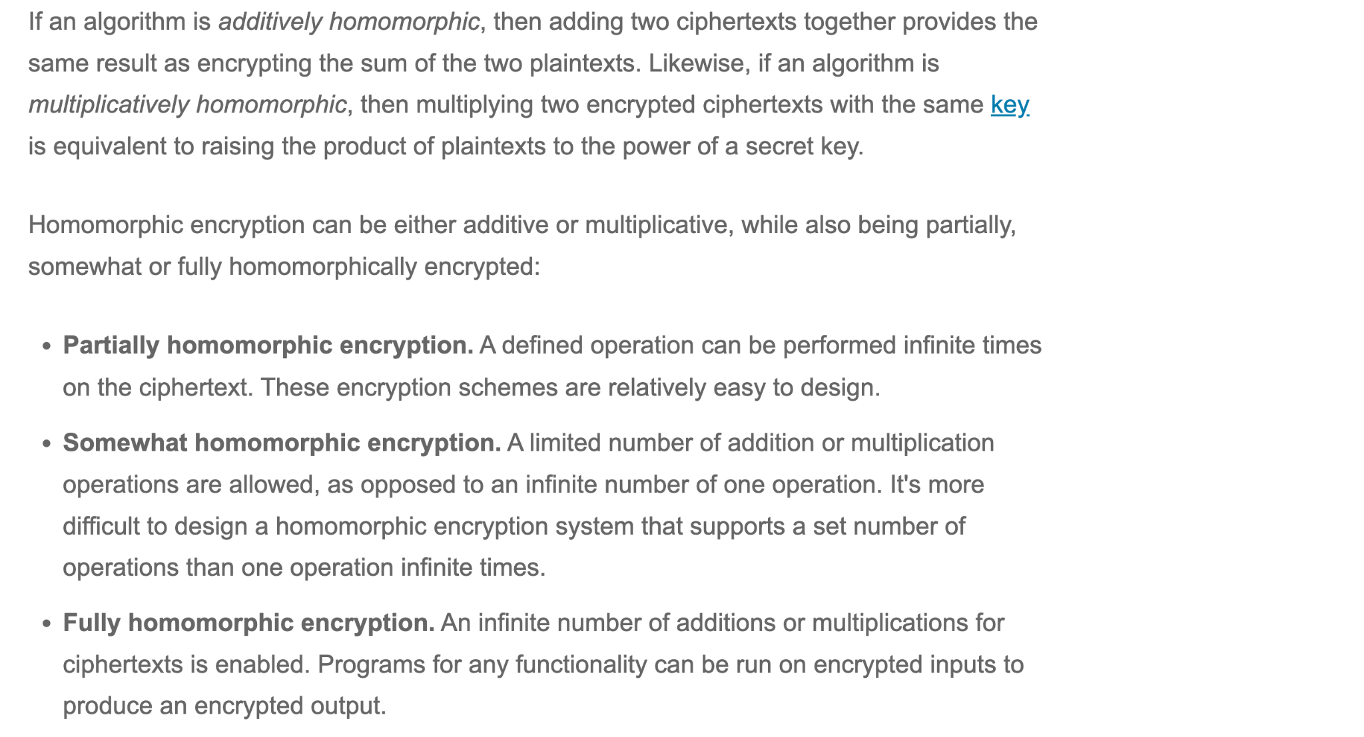

Slide 65
Multi-biometric template protection based on Homomorphic Encryption
https://www.sciencedirect.com/science/article/pii/S0031320317300249
*https://www.sciencedirect.com/science/article/abs/pii/S0045790620307746 iris authentication and FHE

Slide 66
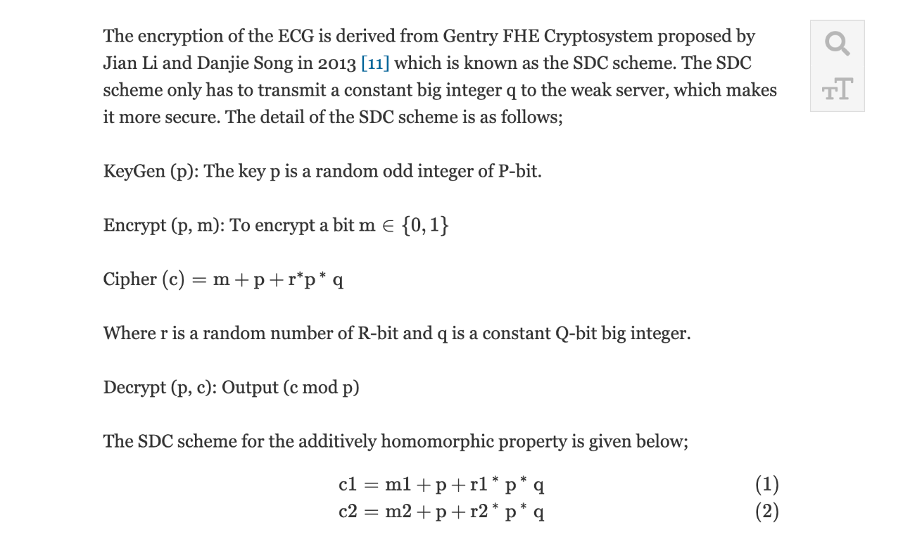
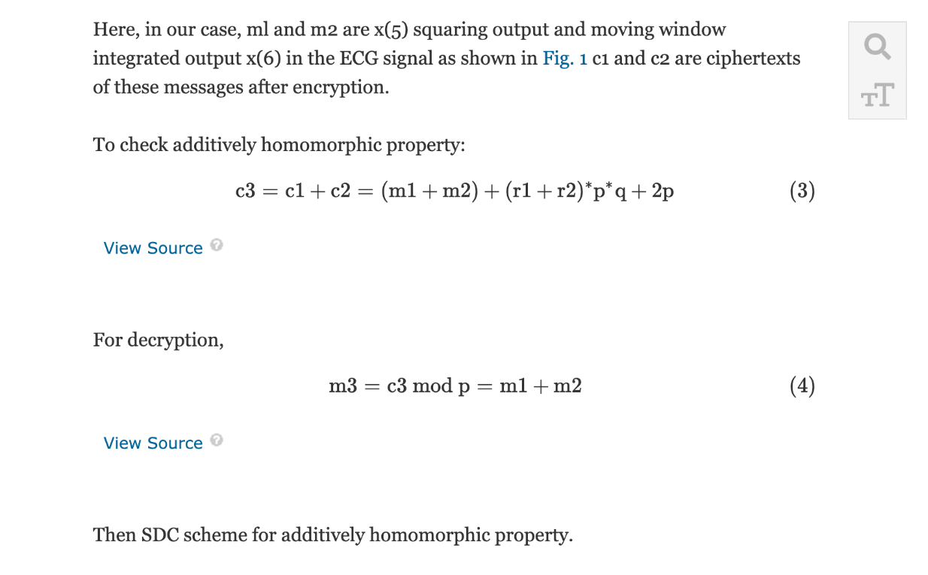
Sensitivity and Positive Prediction of Secured Electrocardiograph (ECG) Transmission using Fully Homomorphic Encryption Technique (FHE)
https://ieeexplore.ieee.org/abstract/document/9398792
database: https://physionet.org/content/mitdb/1.0.0/

Slide 67
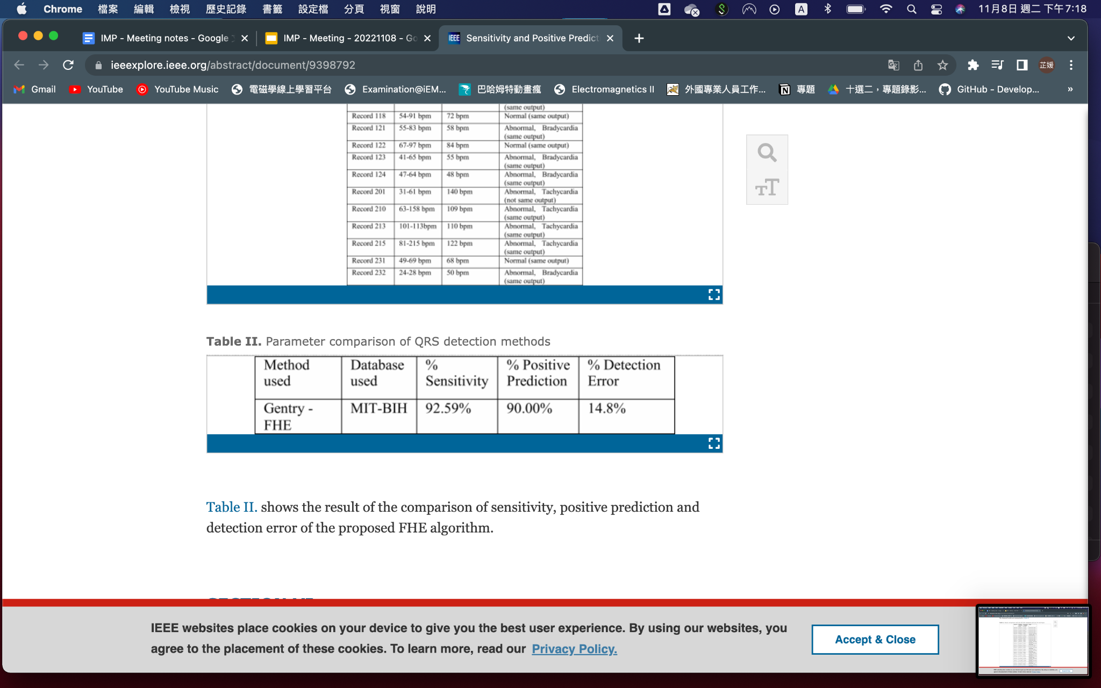
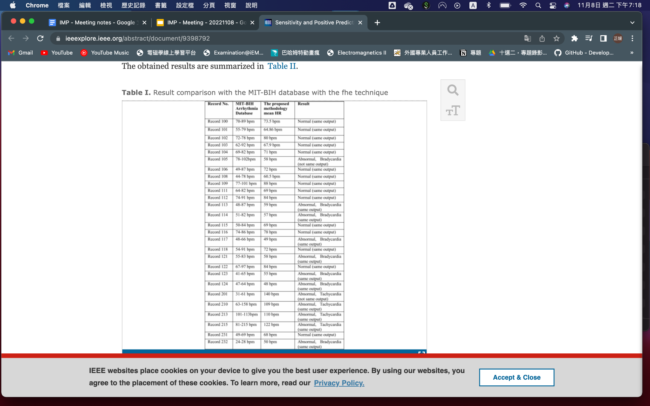

Slide 68
REFERENCE
https://www.healthcare.digital/single-post/fully-homomorphic-encryption-the-next-big-thing-for-healthcare-data example case and video about it
https://www.sciencedirect.com/science/article/abs/pii/S0045790620307746 iris authentication and FHE
https://ieeexplore.ieee.org/abstract/document/9398792 ECG signal and telemedicine and FHE
https://link.springer.com/chapter/10.1007/978-981-13-7082-3_32 FHE enhance security of data
https://ieeexplore.ieee.org/abstract/document/9523794 blockchain and vehicle systema and FHE
https://eprint.iacr.org/2019/1113.pdf Towards a Homomorphic Machine Learning Big Data Pipeline for the Financial Services Sector
https://www.sciencedirect.com/science/article/pii/S240547122100288X
Ultrafast homomorphic encryption models enable secure outsourcing of genotype imputation

Slide 69
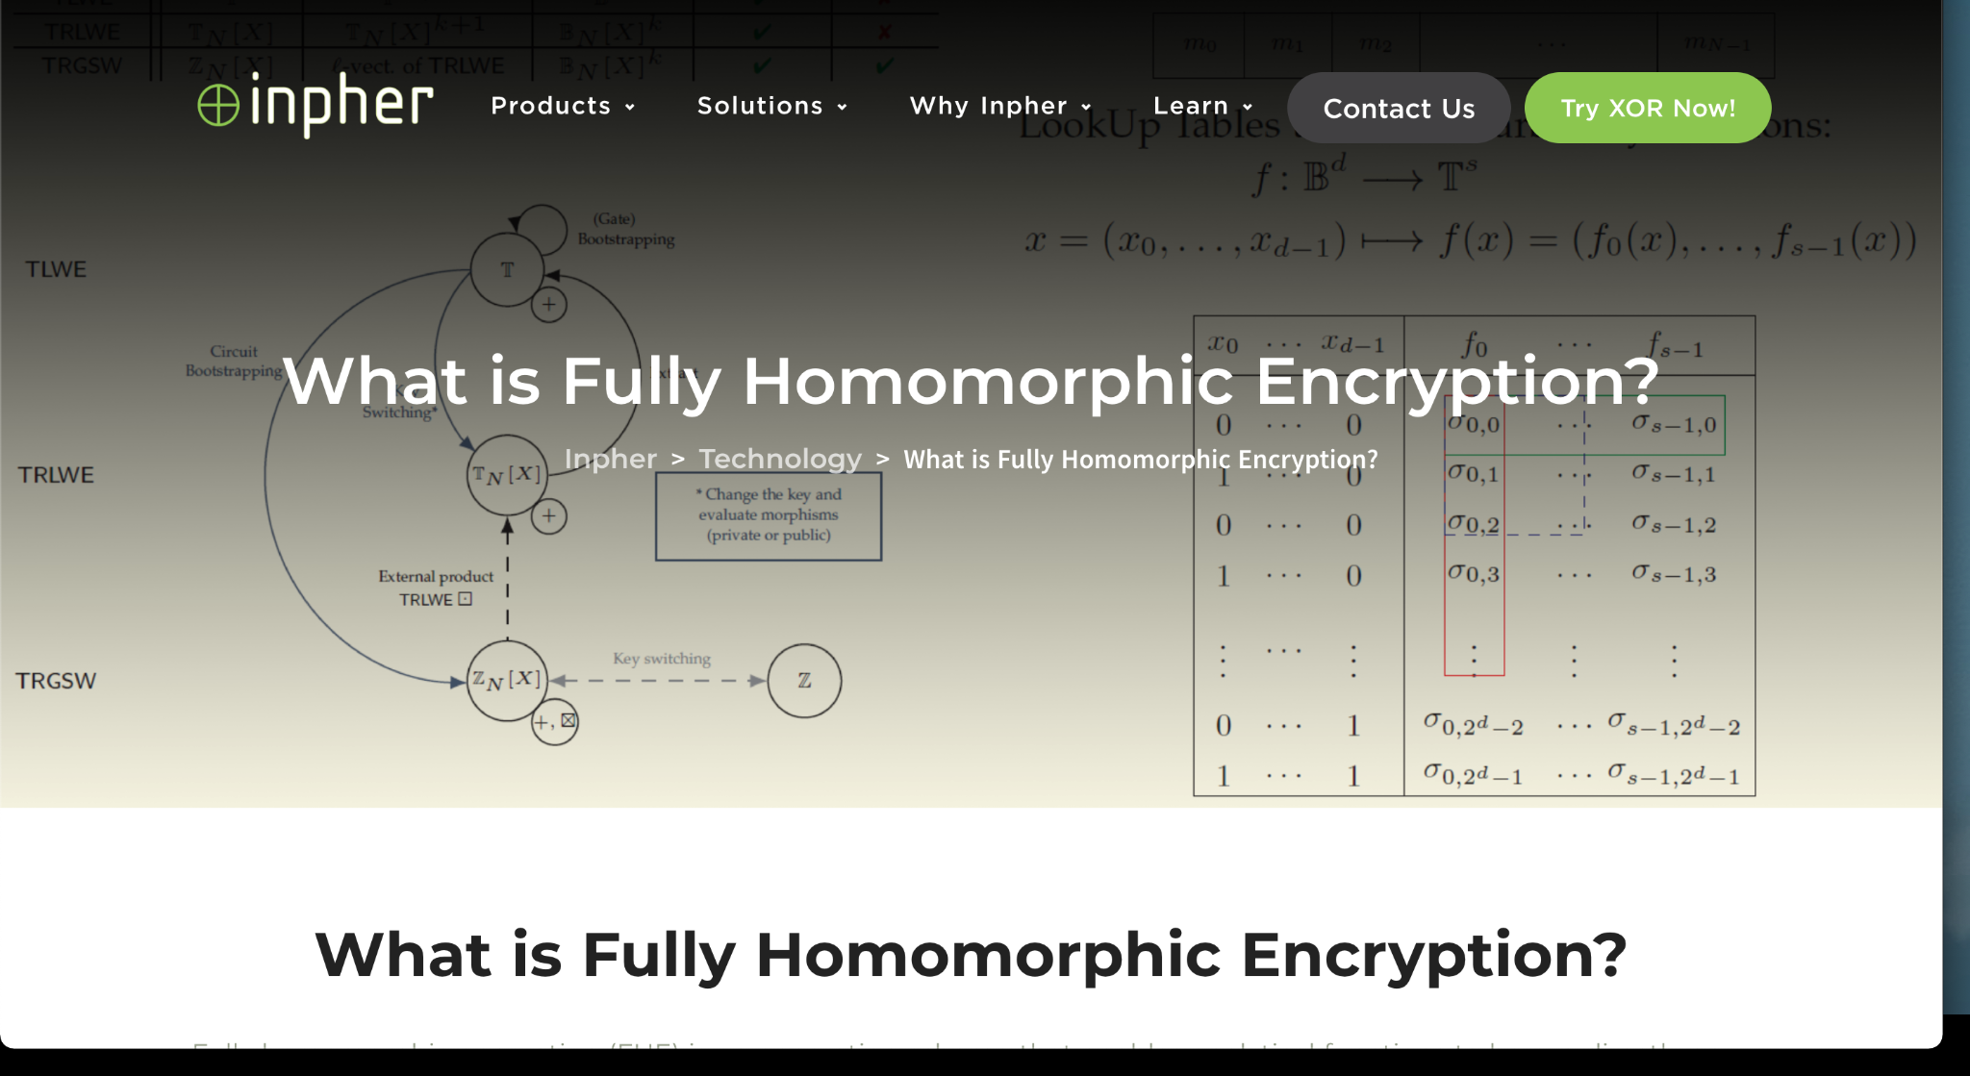
Reference
https://inpher.io/learn/research/

Slide 70
IBM Fully Homomorphic Encryption Toolkit for MacOS
https://github.com/IBM/fhe-toolkit-macos#readme

Slide 71
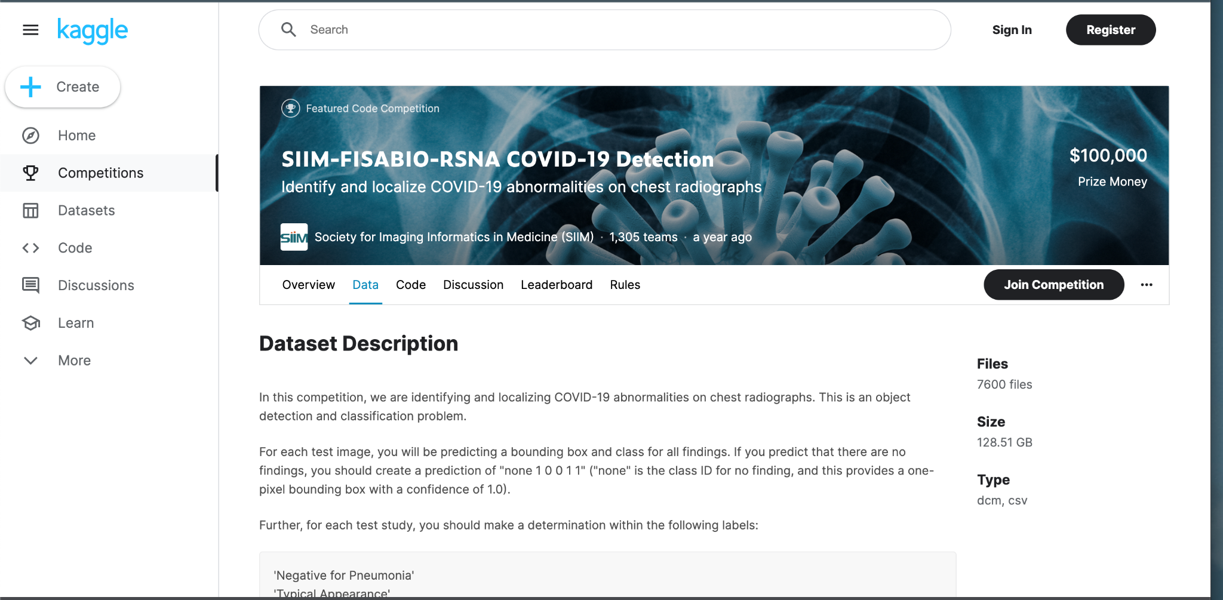
DATA
不確定可不可以用
https://www.kaggle.com/competitions/siim-covid19-detection/data

Slide 72
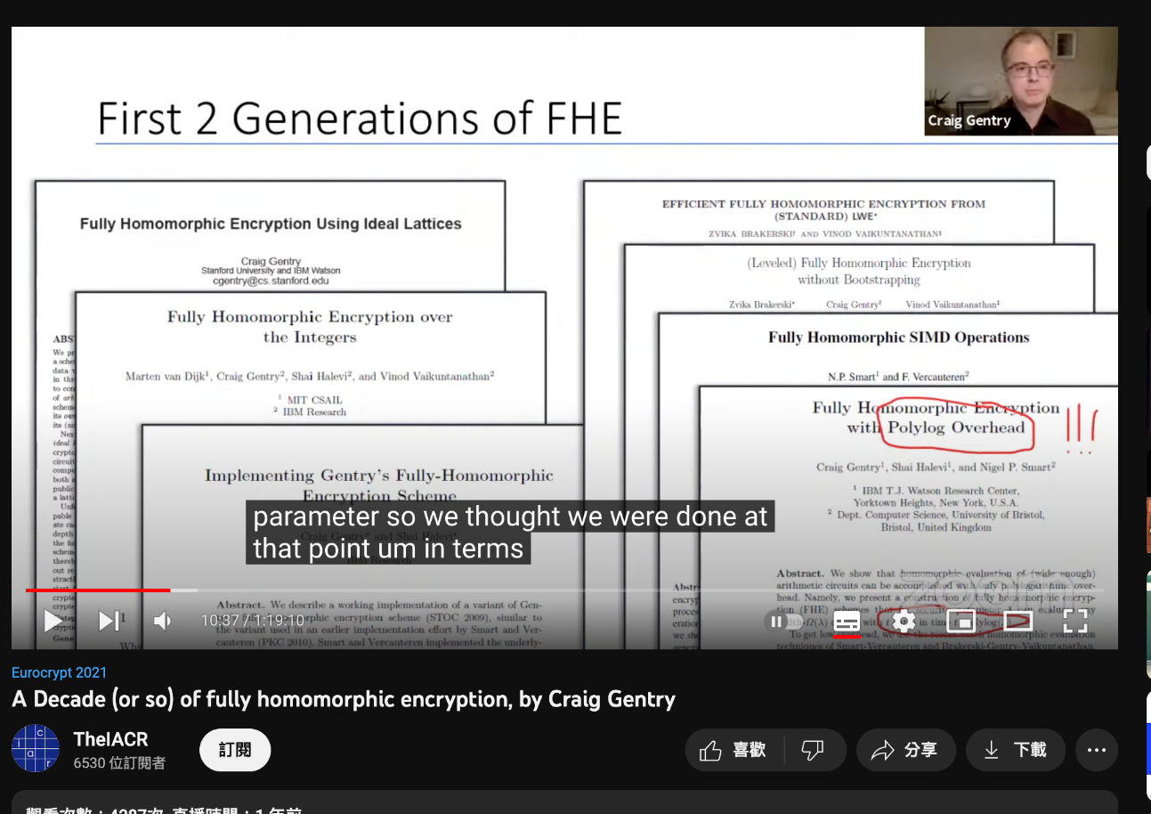
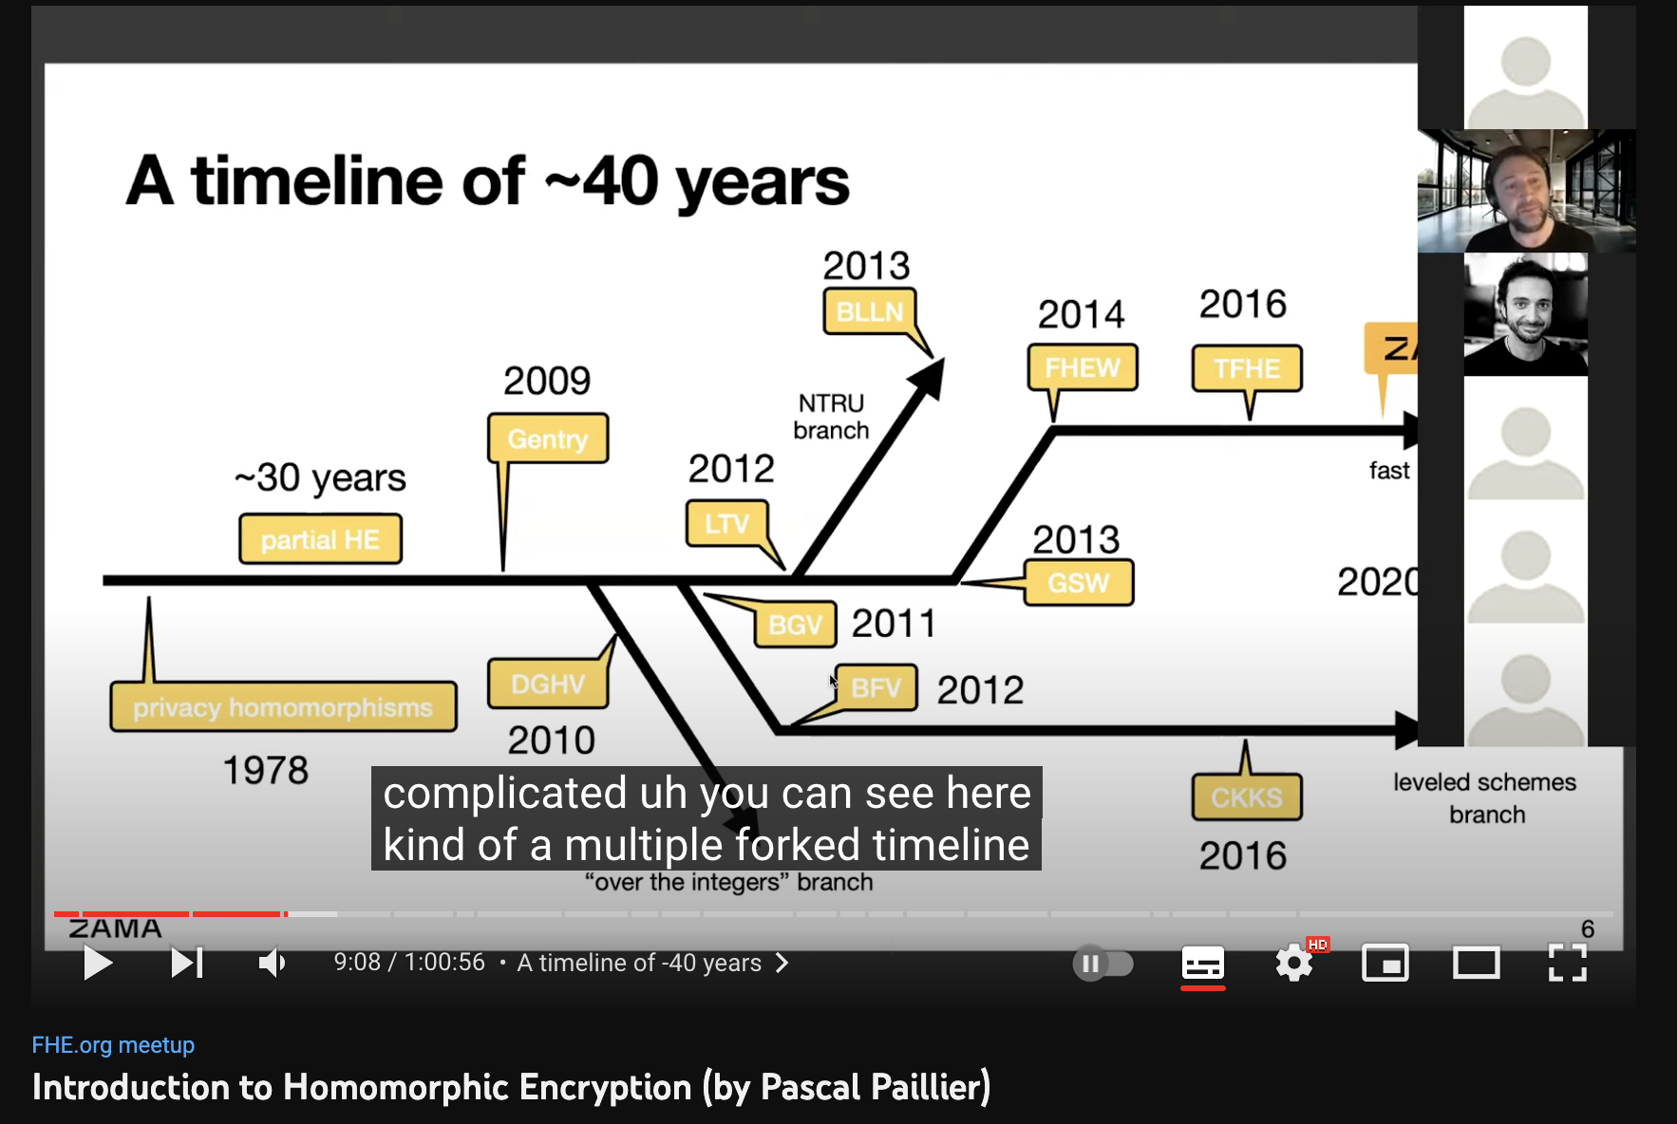
https://www.youtube.com/watch?v=487AjvFW1lk
https://www.youtube.com/watch?v=umqz7kKWxyw

Slide 73
區塊鏈 + 零知識驗證
張麒仙

Slide 74
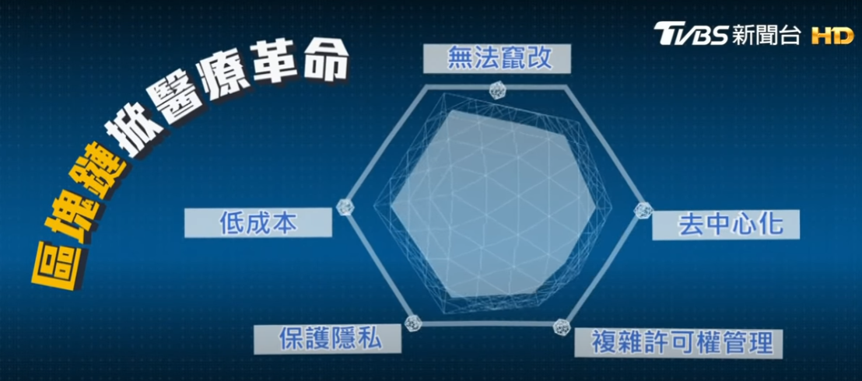
拿回病歷使用主動權 區塊鏈掀醫療革命(北醫)
https://www.youtube.com/watch?v=sDxgKCa2SM8

Slide 75
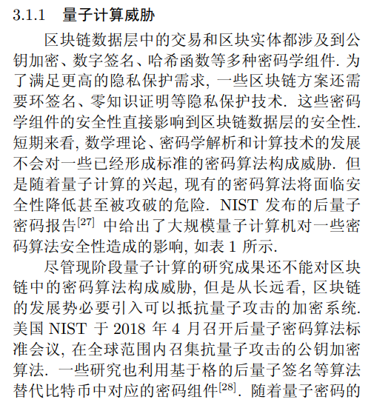
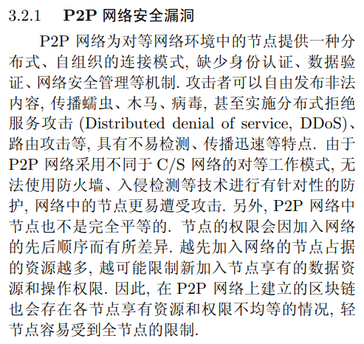
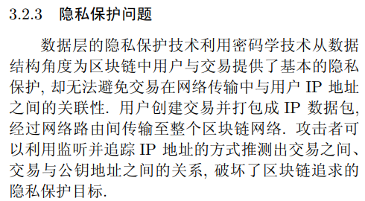
区块链安全问题: 研究现状与展望(2020)
http://www.impcia.net/Uploads/image/file/20190712/20190712125218_80635.pdf

Slide 76
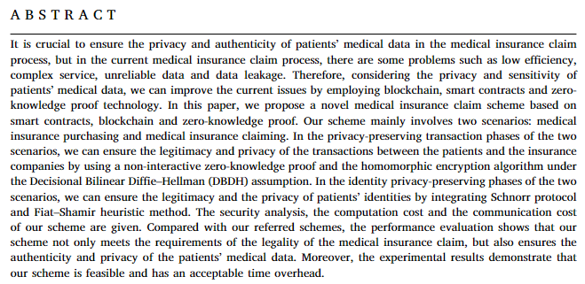
A novel insurance claim blockchain scheme based on zero-knowledge proof technology
滿足醫保理賠的合法性要求，而且保證了患者醫療數據的真實性和隱私性
Notes:
https://reurl.cc/EXZ470

Slide 77
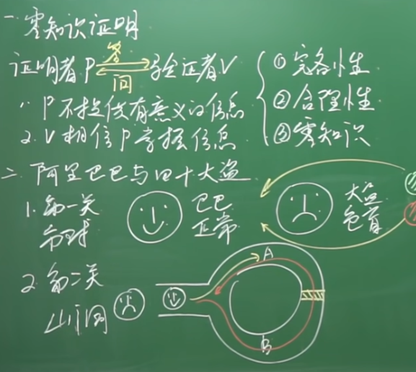
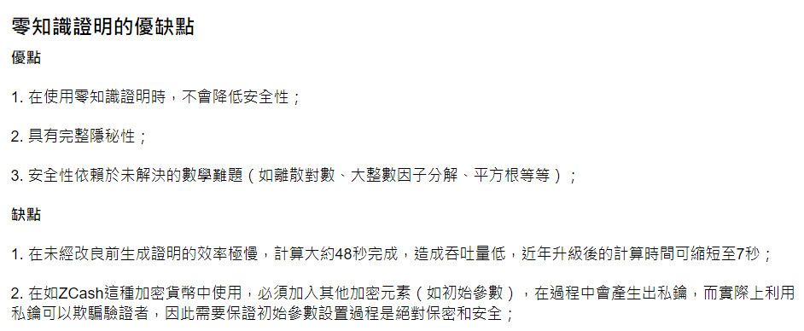
零知識驗證
https://reurl.cc/33571l
Notes:
https://www.blockore.io/zh-tw/blog/ling-zhi-shi-zheng-ming-zero-knowledge-proof/?fbclid=IwAR2I2f-G9FIae30UnQTvsQgtdwkdWz2yY3IIckuaf3IxyiFpYEwJUn6FSZQ

Slide 78
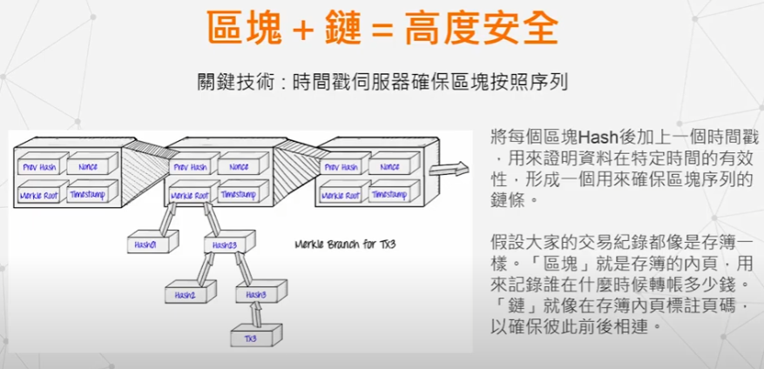
區塊鏈技術：補足醫療與AI的最後一道缺口
https://www.youtube.com/watch?v=4nzYA2YcVUc
https://www.youtube.com/watch?v=s5u7WEXp7KI
https://ithelp.ithome.com.tw/articles/10263873

Slide 79
Reference
Advances in Blockchain Security (2022)
https://link.springer.com/content/pdf/10.1007/978-3-031-07535-3.pdf
A novel insurance claim blockchain scheme based on zero-knowledge proof technology (2022)
https://reurl.cc/EXZ470
A Survey on the Security of Blockchain Systems (2017)
https://www.researchgate.net/publication/319249505_A_Survey_on_the_Security_of_Blockchain_Systems
Design of a Secure Medical Data Sharing Scheme Based on Blockchain (2020)
https://link.springer.com/content/pdf/10.1007/s10916-019-1468-1.pdf

